Slide 1
IPL 2025: Boon for the Economy or Burden on Society?

Slide 2
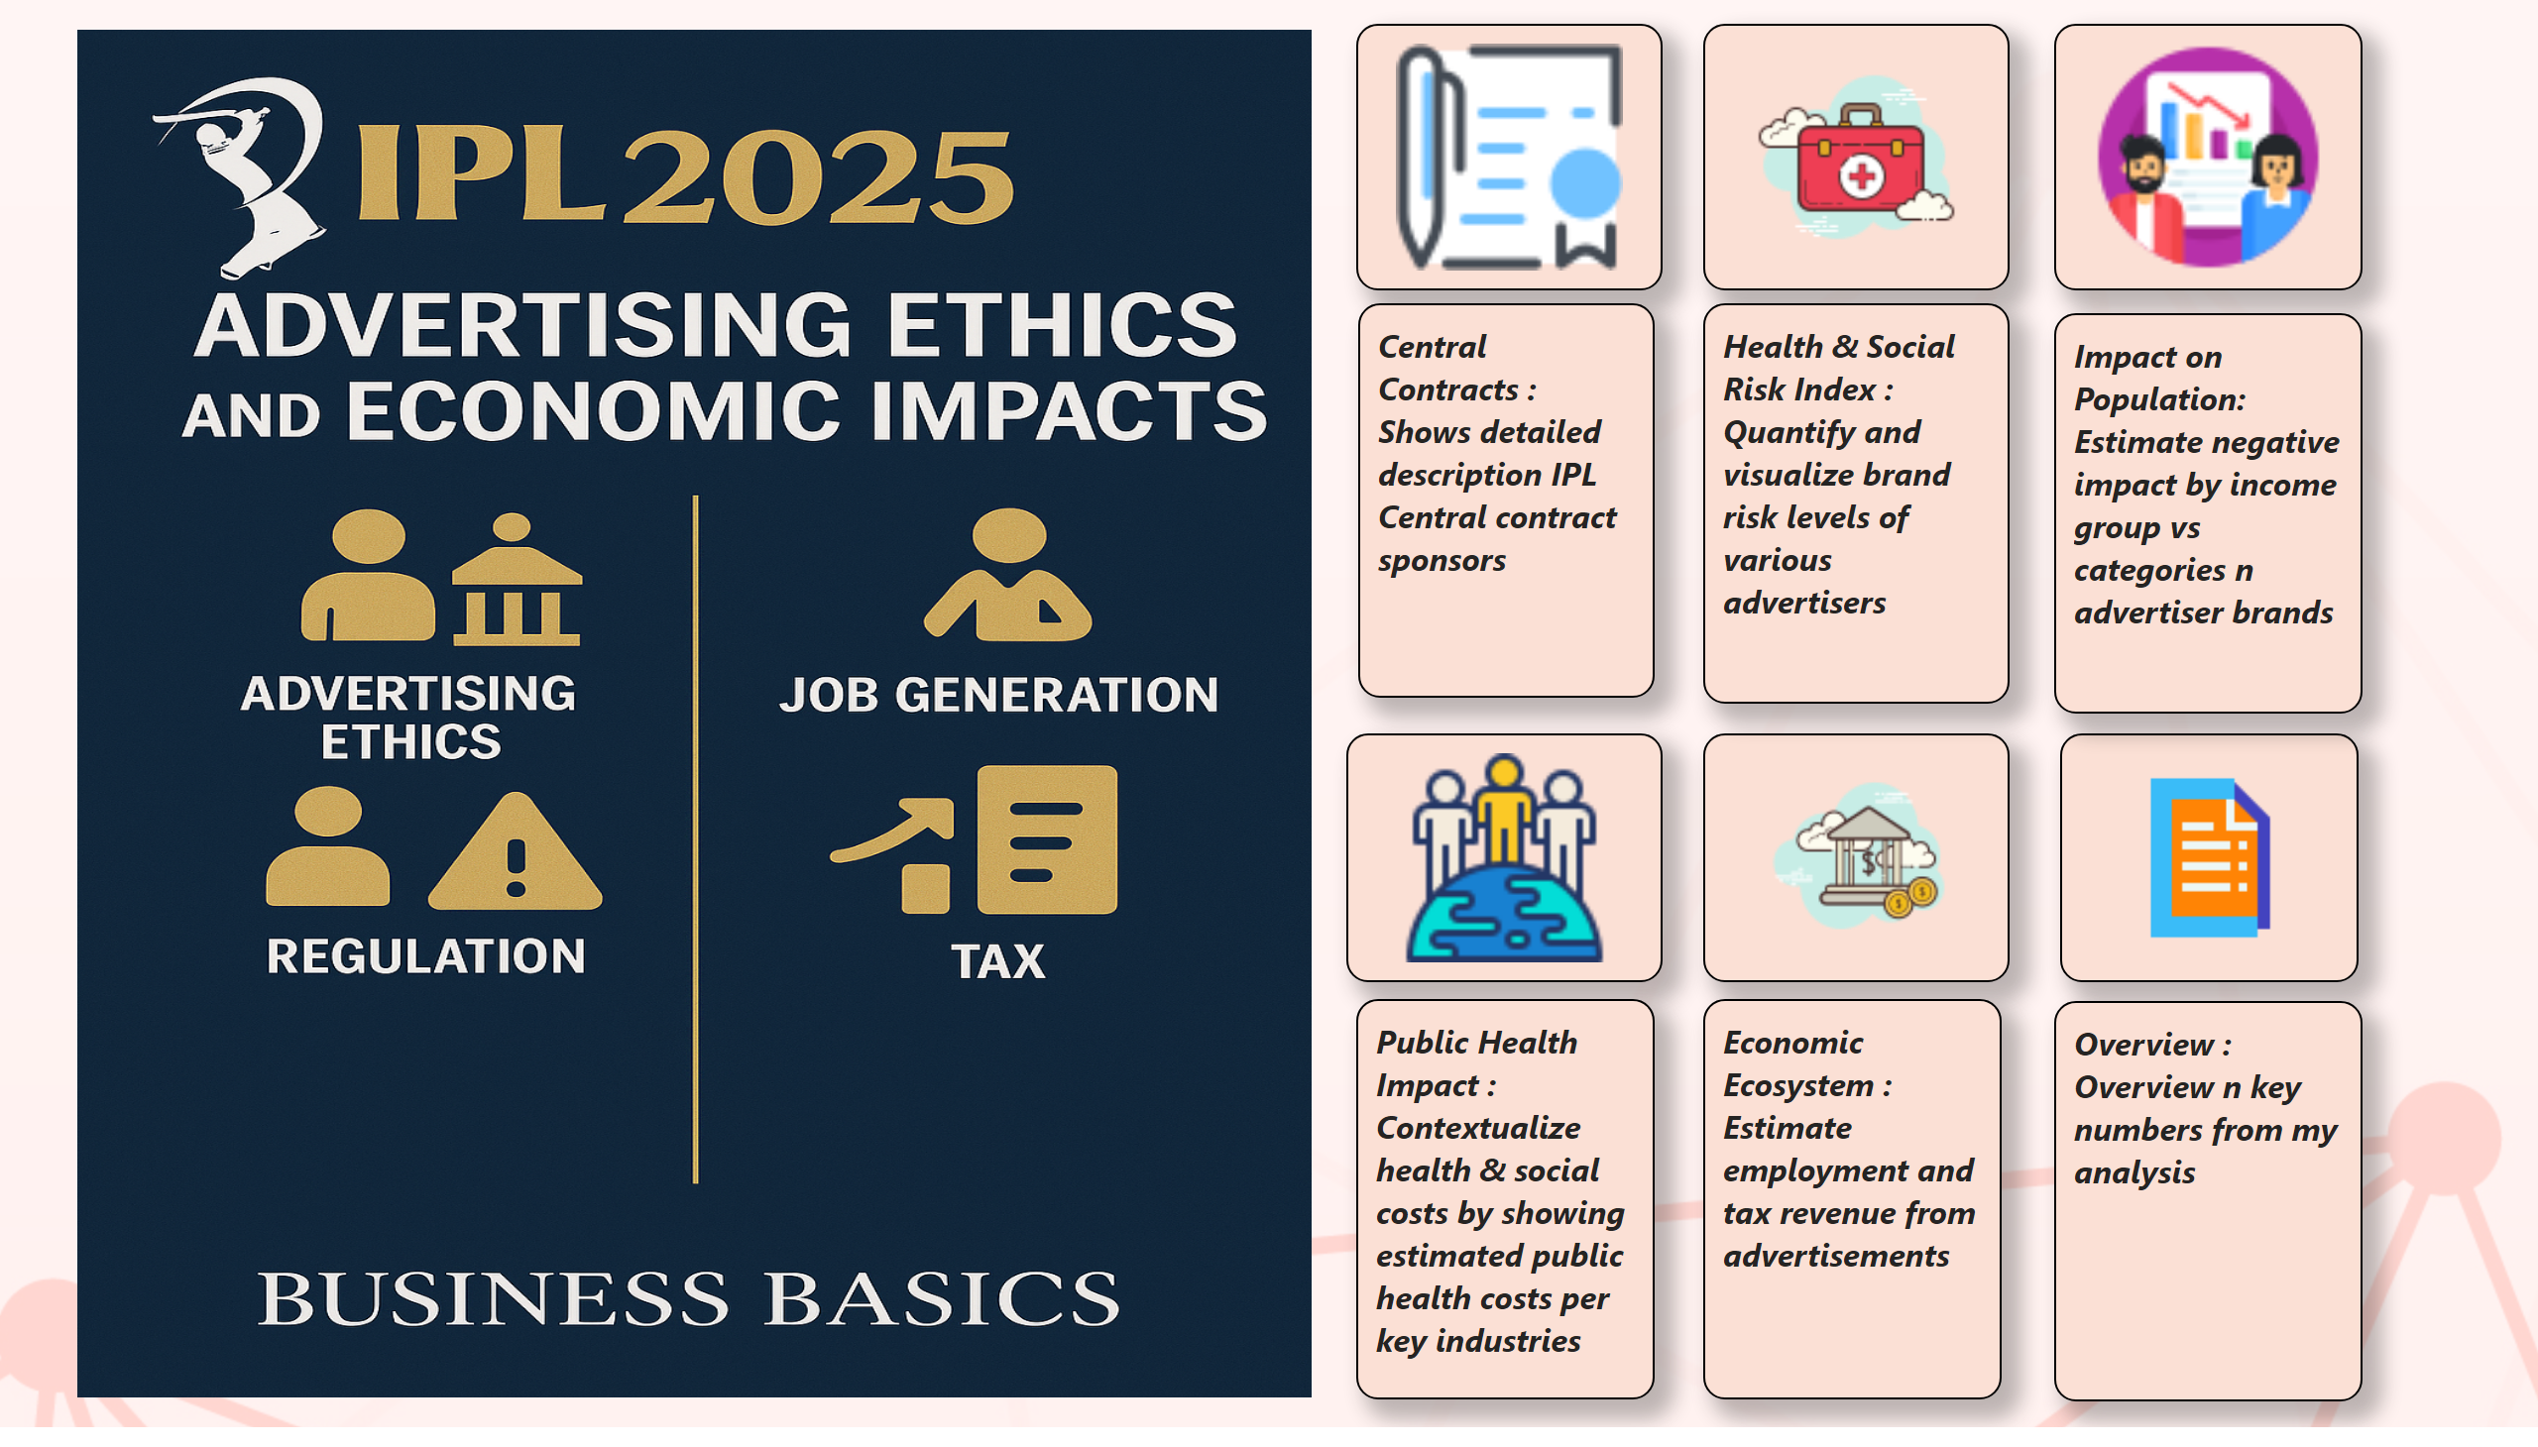
Homepage
Notes:
image
No alt text provided
image
No alt text provided
image
No alt text provided
image
No alt text provided
image
No alt text provided
image
No alt text provided
textbox
No alt text provided
textbox
No alt text provided
textbox
No alt text provided
textbox
No alt text provided
textbox
No alt text provided
textbox
No alt text provided
image
No alt text provided

Slide 3
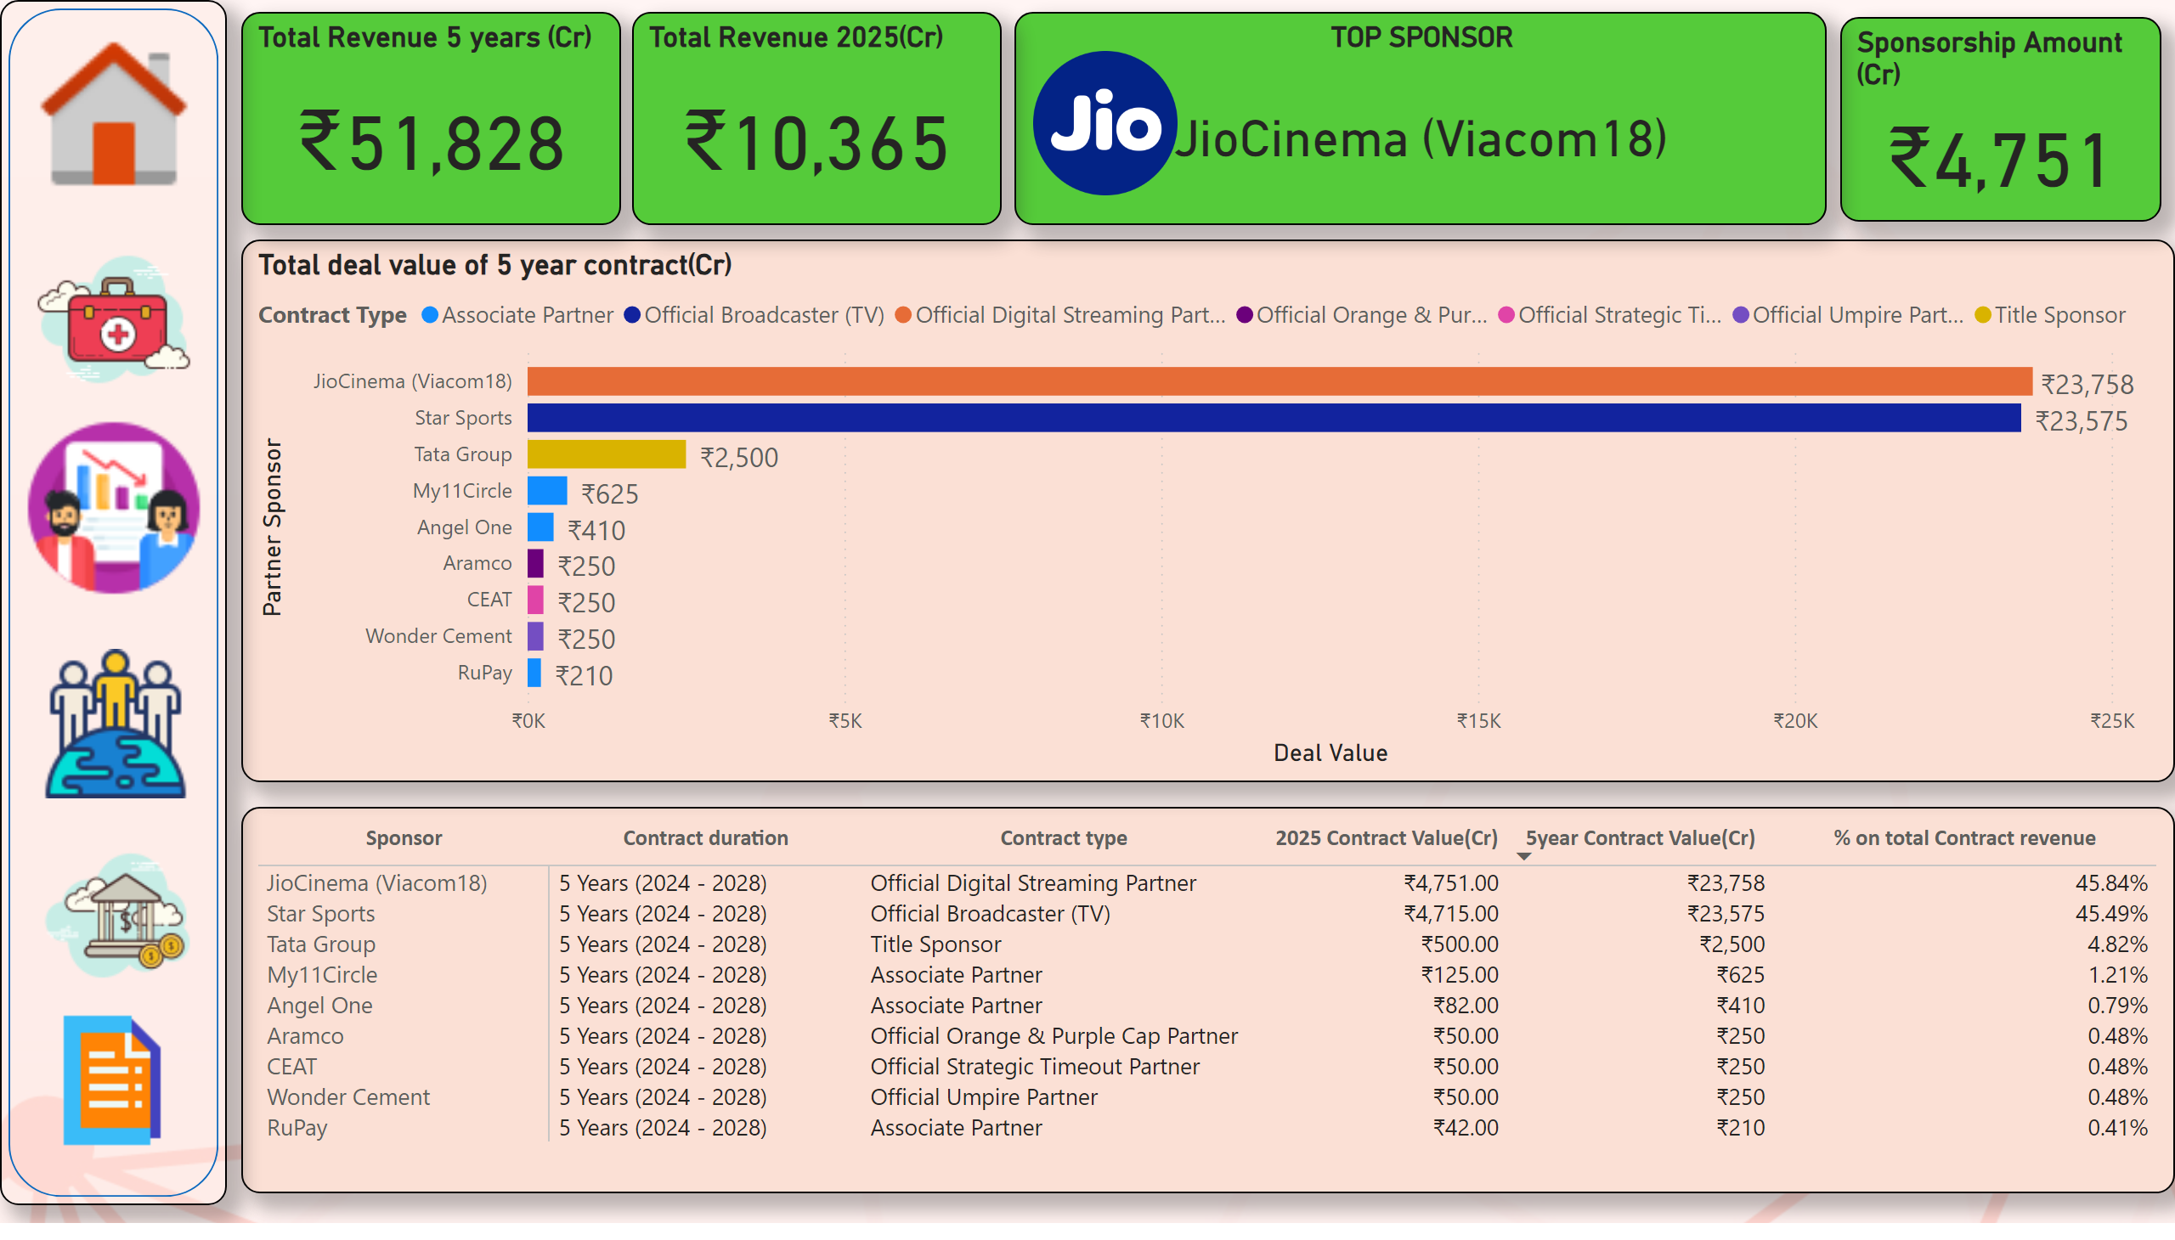
Central Contract Revenue Breakdown
Notes:
pivotTable
No alt text provided
Total deal value of 5 year contract(Cr)
No alt text provided
Total Revenue 5 years (Cr)
No alt text provided
Sponsorship Amount (Cr)
No alt text provided
TOP SPONSOR
No alt text provided
image
No alt text provided
shape
No alt text provided
image
No alt text provided
image
No alt text provided
image
No alt text provided
image
No alt text provided
image
No alt text provided
image
No alt text provided
Total Revenue 2025(Cr)
No alt text provided

Slide 4
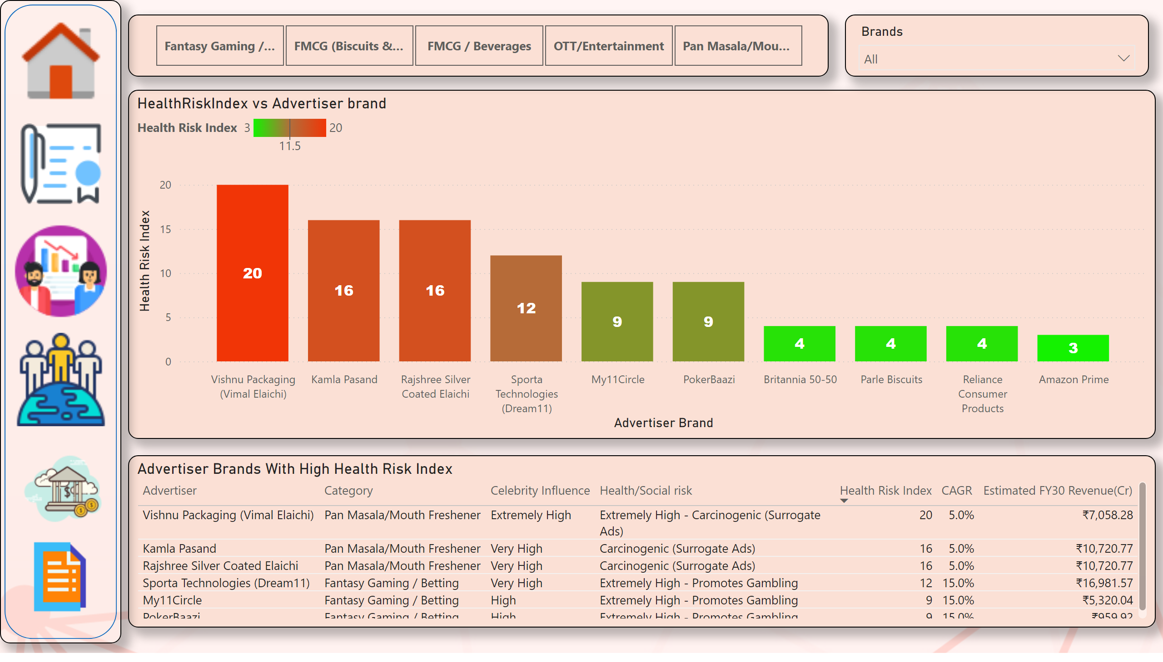
Health & Social Risk Index
Notes:
HealthRiskIndex vs Advertiser brand
No alt text provided
Advertiser Brands With High Health Risk Index
No alt text provided
slicer
No alt text provided
slicer
No alt text provided
shape
No alt text provided
image
No alt text provided
image
No alt text provided
image
No alt text provided
image
No alt text provided
image
No alt text provided
image
No alt text provided

Slide 5
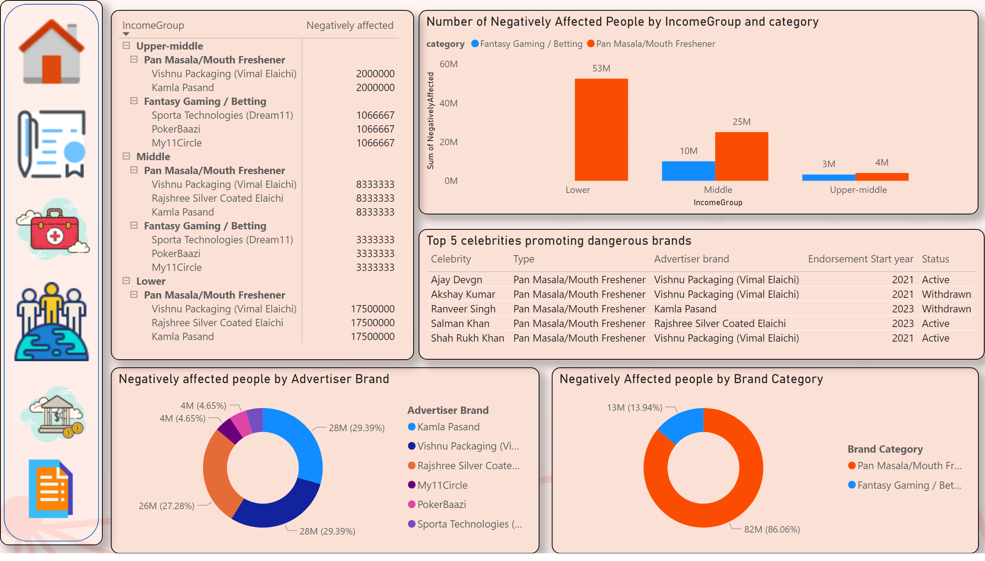
Impact on Population
Notes:
Number of Negatively Affected People by IncomeGroup and category
No alt text provided
donutChart
No alt text provided
donutChart
No alt text provided
pivotTable
No alt text provided
Top 5 celebrities promoting dangerous brands
No alt text provided
shape
No alt text provided
image
No alt text provided
image
No alt text provided
image
No alt text provided
image
No alt text provided
image
No alt text provided
image
No alt text provided

Slide 6
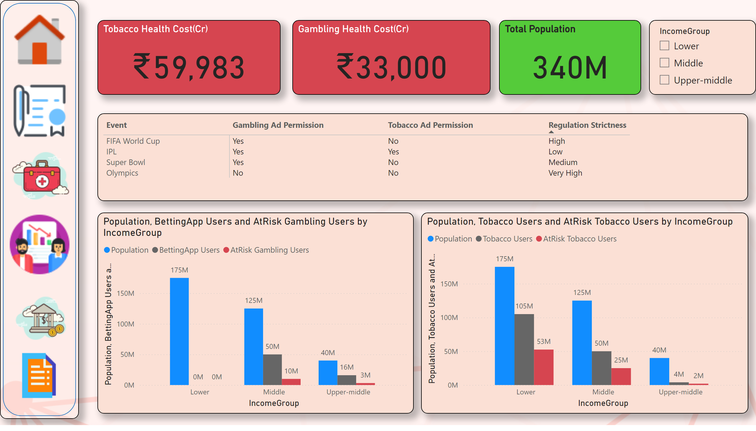
Public Health Impact
Notes:
Tobacco Health Cost(Cr)
No alt text provided
Gambling Health Cost(Cr)
No alt text provided
Total Population
No alt text provided
clusteredColumnChart
No alt text provided
clusteredColumnChart
No alt text provided
pivotTable
No alt text provided
slicer
No alt text provided
shape
No alt text provided
image
No alt text provided
image
No alt text provided
image
No alt text provided
image
No alt text provided
image
No alt text provided
image
No alt text provided

Slide 7
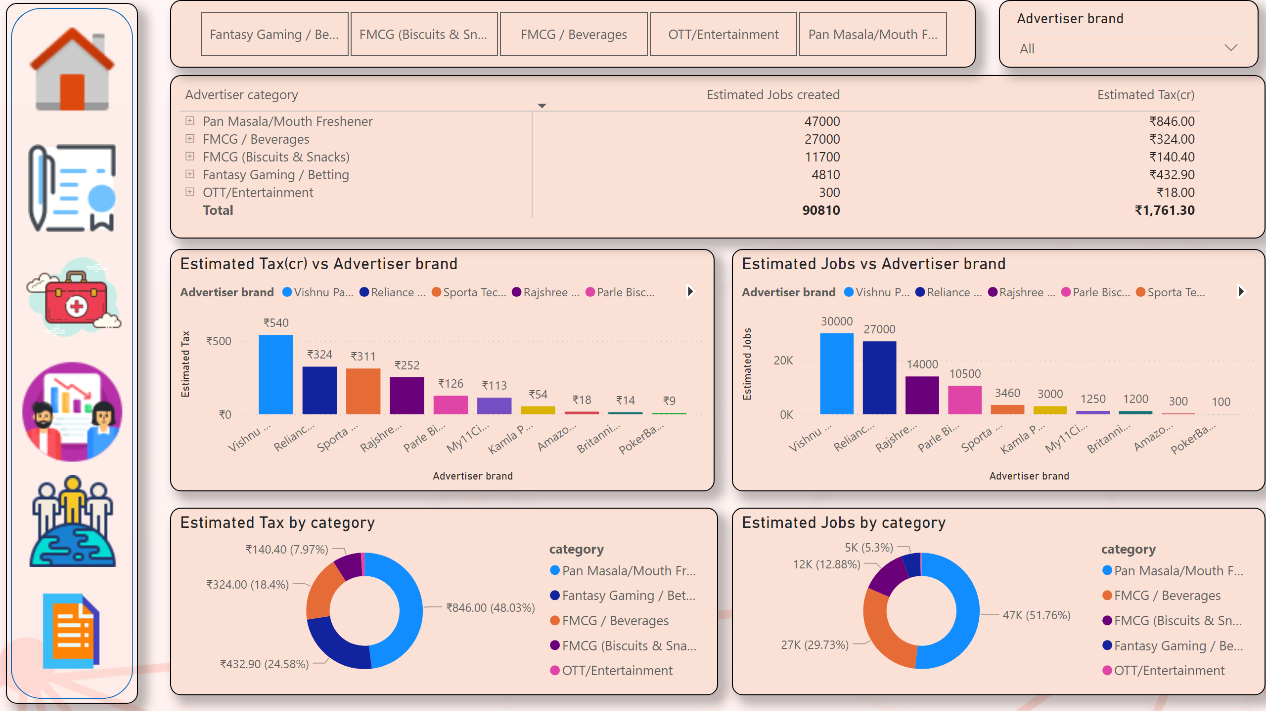
Economic Ecosystem
Notes:
donutChart
No alt text provided
Estimated Jobs vs Advertiser brand
No alt text provided
Estimated Tax(cr) vs Advertiser brand
No alt text provided
pivotTable
No alt text provided
donutChart
No alt text provided
slicer
No alt text provided
slicer
No alt text provided
shape
No alt text provided
image
No alt text provided
image
No alt text provided
image
No alt text provided
image
No alt text provided
image
No alt text provided
image
No alt text provided

Slide 8
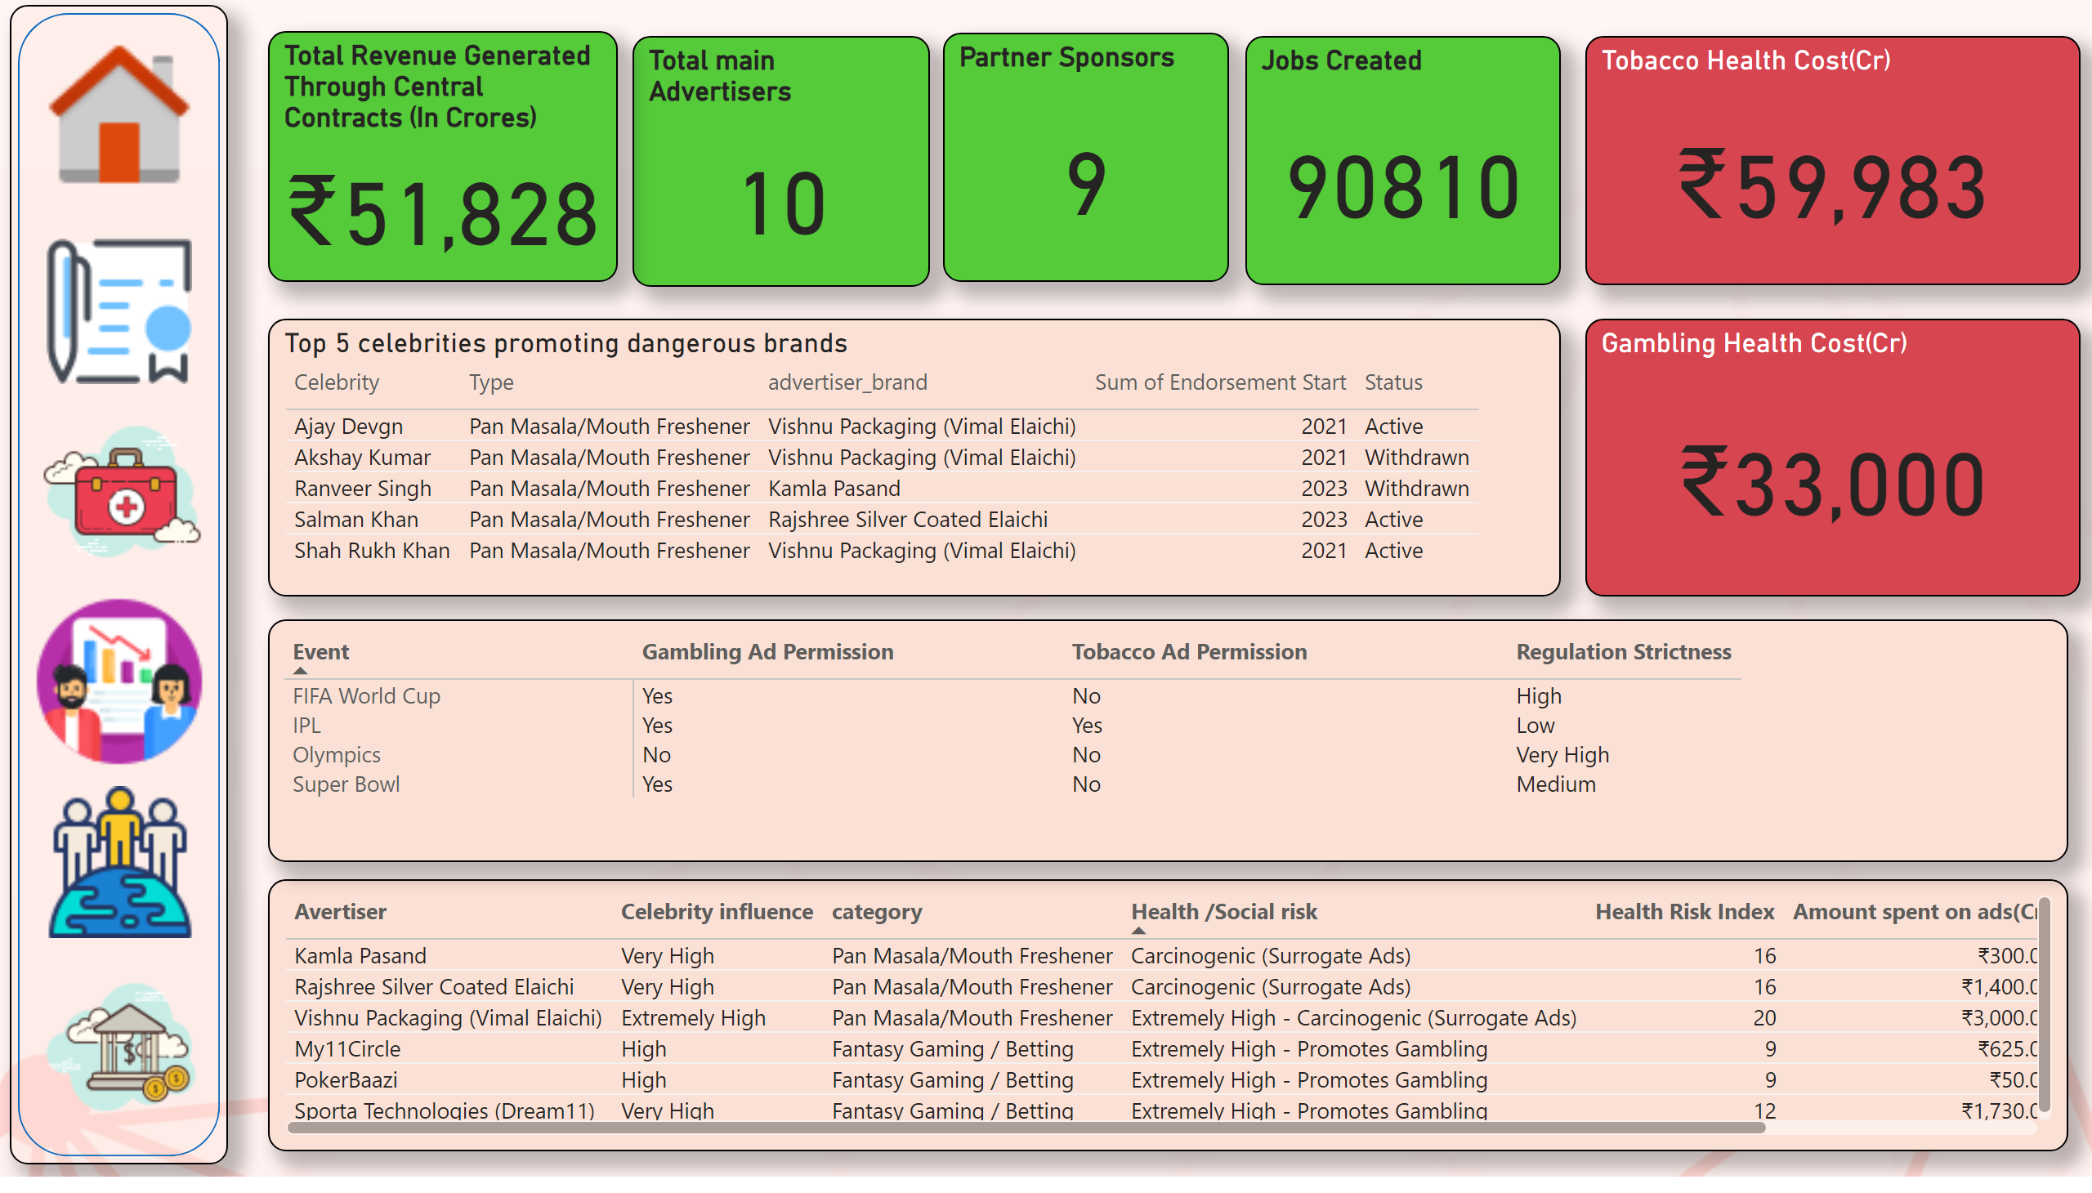
Overview
Notes:
Total main Advertisers
No alt text provided
tableEx
No alt text provided
Partner Sponsors
No alt text provided
shape
No alt text provided
image
No alt text provided
image
No alt text provided
image
No alt text provided
image
No alt text provided
image
No alt text provided
image
No alt text provided
Top 5 celebrities promoting dangerous brands
No alt text provided
Jobs Created
No alt text provided
Total Revenue Generated Through Central Contracts (In Crores)
No alt text provided
Tobacco Health Cost(Cr)
No alt text provided
Gambling Health Cost(Cr)
No alt text provided
pivotTable
No alt text provided

Slide 9
Framework for increasing the economic benefits of IPL while minimizing potential negative social impacts will include the following
Give more ad slots to health, tech, education, and clean energy brands
Limit ads from harmful categories like pan masala and betting apps
Give discounts or tax benefits to companies promoting social good
Highlight responsible brands as “Official Ethical Partners of IPL”
Add health/gambling warnings to risky ads.
Ask big advertisers to show how they are helping society (jobs, health, etc.)

Slide 10
Responsible Advertising Policy for IPL
1. Limit Harmful Product Ads
Only 15% of total ads can come from risky categories (like pan masala, betting apps)
Limit on High risk ad per ad slot.
2. Add Health/Gambling Warnings
All risky ads must include:
A 5-second warning ("This product may harm your health or finances")
Clear visual and voice disclaimers
3. Reward Ethical Brands
Give discounts or bonus ad slots to:
Women-led brands
Green energy, health, or education companies

Slide 11
Strategies for players to evaluate and select endorsement deals based on social impact considerations.
Players be informed about Health / Social Risk Index for every product they sign, and recommended to avoid high Health / Social Risk Index products.
Does this brand align with the player’s values, image, and fanbase
Evaluate if this endorsement support a sustainable image over the next 5–10 years
Prioritize brands that build legacy, not just quick earnings.
BCCI should have a ethics panel to review brand associations for players

